Slide 2
Topics
The if Statement
The if-else Statement
Comparing Strings
Nested Decision Structures and the if-elif-else Statement
Logical Operators
Boolean Variables

Slide 3
The if Statement
Control structure: logical design that controls order in which set of statements execute
Sequence structure: set of statements that execute in the order they appear
Decision structure: specific action(s) performed only if a condition exists
  Also known as selection structure

Slide 4
The if Statement (cont’d.)
In flowchart, diamond represents true/false condition that must be tested
Actions can be conditionally executed
  Performed only when a condition is true
Single alternative decision structure: provides only one alternative path of execution
  If condition is not true, exit the structure

Slide 5
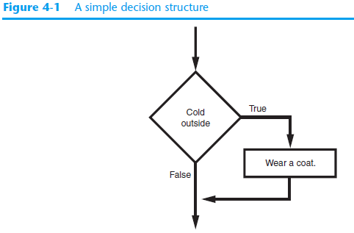
The if Statement (cont’d.)

Slide 6
The if Statement (cont’d.)
Python syntax:
  if condition:
    Statement
    Statement
First line know as the if clause
  Includes the keyword if followed by condition
    The condition can be true or false
    When the if statement executes, the condition is tested, and if it is true the block statements are executed. otherwise, block statements are skipped

Slide 7
Boolean Expressions and Relational Operators
Boolean expression: expression tested by if statement to determine if it is true or false
  Example: a > b
    true if a is greater than b; false otherwise
Relational operator: determines whether a specific relationship exists between two values
  Example: greater than (>)

Slide 8
Boolean Expressions and Relational Operators (cont’d.)
>= and <= operators test more than one relationship
  It is enough for one of the relationships to exist for the expression to be true
== operator determines whether the two operands are equal to one another
  Do not confuse with assignment operator (=)
!= operator determines whether the two operands are not equal

Slide 9
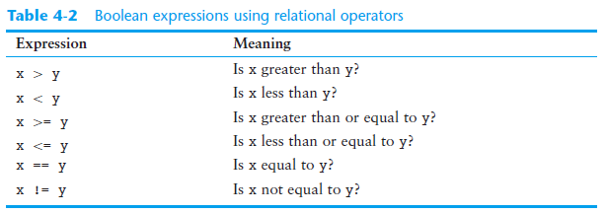
Boolean Expressions and Relational Operators (cont’d.)

Slide 10
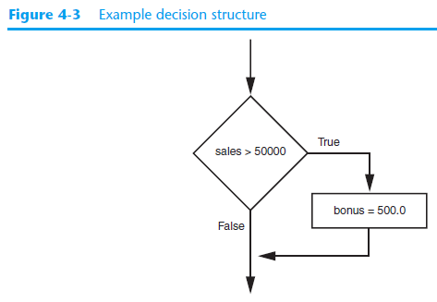
Boolean Expressions and Relational Operators (cont’d.)
Using a Boolean expression with the > relational operator

Slide 11
Boolean Expressions and Relational Operators (cont’d.)
Any relational operator can be used in a decision block
  Example: if balance == 0
  Example: if payment != balance
It is possible to have a block inside another block
  Example: if statement inside a function
  Statements in inner block must be indented with respect to the outer block

Slide 12
The if-else Statement
Dual alternative decision structure: two possible paths of execution
  One is taken if the condition is true, and the other if the condition is false
  Syntax: if condition:
    statements
    else:
    other statements
  if clause and else clause must be aligned
  Statements must be consistently indented

Slide 13
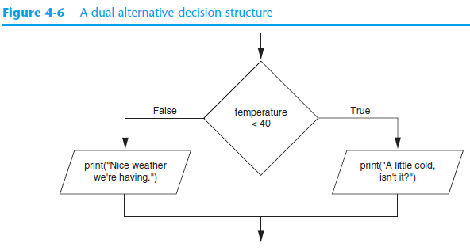
The if-else Statement (cont’d.)

Slide 14
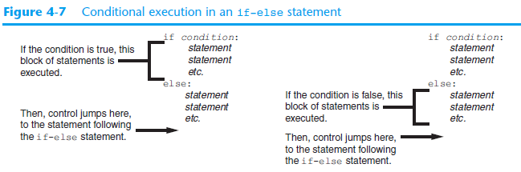
The if-else Statement (cont’d.)

Slide 15
Comparing Strings
Strings can be compared using the == and != operators
String comparisons are case sensitive
Strings can be compared using >, <, >=, and <=
  Compared character by character based on the ASCII values for each character
  If shorter word is substring of longer word, longer word is greater than shorter word

Slide 16
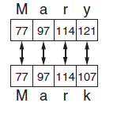
Comparing Strings (cont’d.)

Slide 17
Nested Decision Structures and the if-elif-else Statement
A decision structure can be nested inside another decision structure
  Commonly needed in programs
  Example:
    Determine if someone qualifies for a loan, they must meet two conditions:
      Must earn at least $30,000/year
      Must have been employed for at least two years
    Check first condition, and if it is true, check second condition

Slide 18
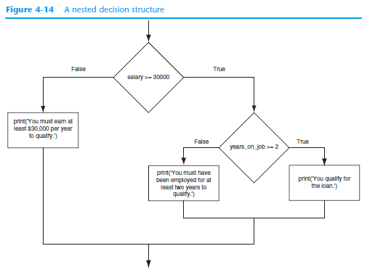

Slide 19
Nested Decision Structures and the if-elif-else Statement (cont’d.)
Important to use proper indentation in a nested decision structure
  Important for Python interpreter
  Makes code more readable for programmer
  Rules for writing nested if statements:
    else clause should align with matching if clause
    Statements in each block must be consistently indented

Slide 20
The if-elif-else Statement
if-elif-else statement: special version of a decision structure
  Makes logic of nested decision structures simpler to write
    Can include multiple elif statements
  Syntax: if condition1
    statements
    elif condition2
    statements
    else
    statements

Slide 21
The if-elif-else Statement (cont’d.)
Alignment used with if-elif-else statement:
  if, elif, and else clauses are all aligned
  Conditionally executed blocks are consistently indented
if-elif-else statement is never required, but logic easier to follow
  Can be accomplished by nested if-else
    Code can become complex, and indentation can cause problematic long lines

Slide 22
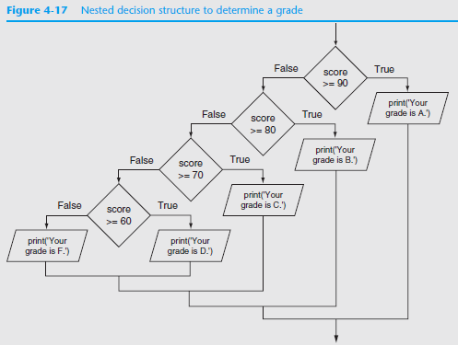

Slide 23
Logical Operators
Logical operators: operators that can be used to create complex Boolean expressions
  and operator and or operator: binary operators, connect two Boolean expressions into a compound Boolean expression
  not operator: unary operator, reverses the truth of its Boolean operand

Slide 24
The and Operator
Takes two Boolean expressions as operands
  Creates compound Boolean expression that is true only when both sub expressions are true
  Can be used to simplify nested decision structures
Truth table for
the and operator
Expression | Value of the Expression
false and false | false
false and true | false
true and false | false
true and true | true

Slide 25
The or Operator
Takes two Boolean expressions as operands
  Creates compound Boolean expression that is true when either of the sub expressions is true
  Can be used to simplify nested decision structures
Truth table for
the or operator
Expression | Value of the Expression
false and false | false
false and true | true
true and false | true
true and true | true

Slide 26
Short-Circuit Evaluation
Short circuit evaluation: deciding the value of a compound Boolean expression after evaluating only one sub expression
  Performed by the or and and operators
    For or operator: If left operand is true, compound expression is true. Otherwise, evaluate right operand
    For and operator: If left operand is false, compound expression is false. Otherwise, evaluate right operand

Slide 27
The not Operator
Takes one Boolean expressions as operand and reverses its logical value
  Sometimes it may be necessary to place parentheses around an expression to clarify to what you are applying the not operator
Truth table for the not operator
Expression | Value of the Expression
true | false
false | true

Slide 28
Checking Numeric Ranges with Logical Operators
To determine whether a numeric value is within a specific range of values, use and
  Example: x >= 10 and x <= 20
To determine whether a numeric value is outside of a specific range of values, use or
  Example: x < 10 or x > 20

Slide 29
Boolean Variables
Boolean variable: references one of two values, True or False
  Represented by bool data type
Commonly used as flags
  Flag: variable that signals when some condition exists in a program
    Flag set to False → condition does not exist
    Flag set to True → condition exists

Slide 30
Summary
This chapter covered:
  Decision structures, including:
    Single alternative decision structures
    Dual alternative decision structures
    Nested decision structures
  Relational operators and logical operators as used in creating Boolean expressions
  String comparison as used in creating Boolean expressions
  Boolean variables

